Slide 1
Final Project - Defensive Report
Mali, Josh, Malladi

Slide 2
Blue Team
Table of Contents
Network Topology
Critical Vulnerabilities
Alerts
Hardening

Slide 3
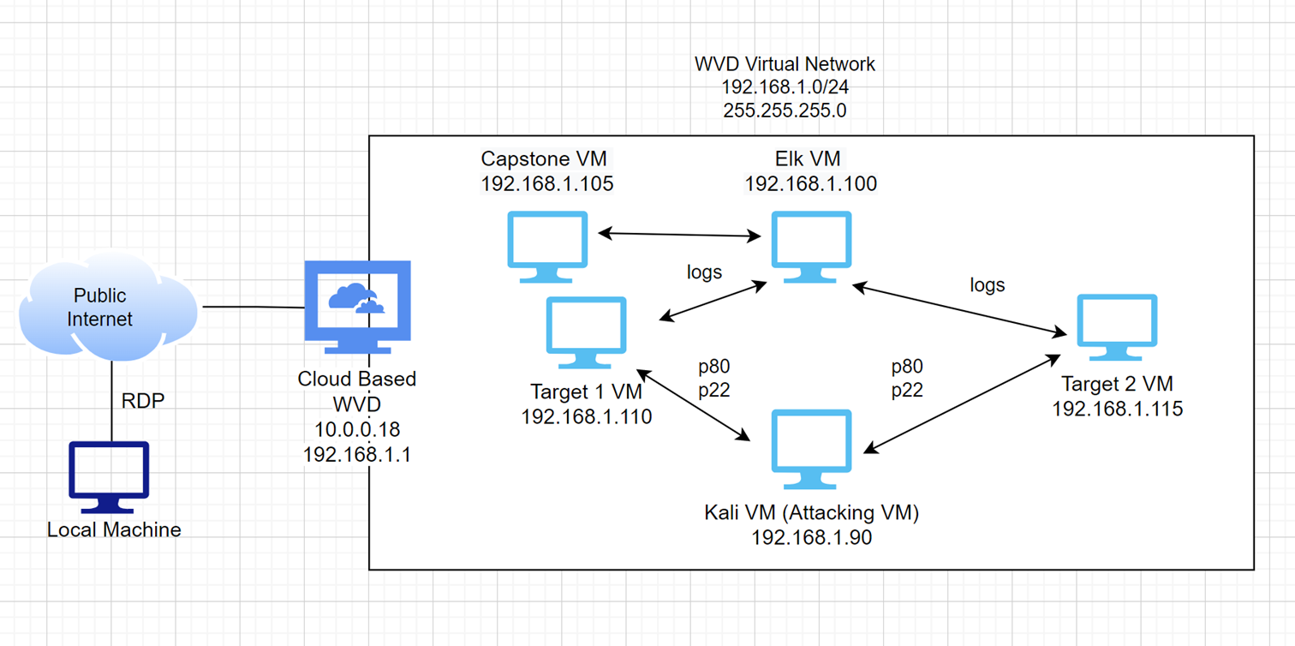
Network Topology
Address Range: 192.168.1.0/24
Netmask: 255.255.255.0
Machines
IPv4:192.168.1.1
OS: Windows
Hostname: Windows VD
IPv4: 192.168.1.90
OS: Linux Debian
Hostname: Kali VM
IPv4: 192.168.1.100
OS: Linux
Hostname: Elk VM
IPv4: 192.168.1.105
OS: Linux
Hostname: Capstone VM
IPv4: 192.168.1.110
OS: Linux
Hostname: Target1
IPv4: 192.168.1.115
OS: Linux
Hostname: Target2

Slide 4
Critical Vulnerabilities: Target 1
Vulnerability | Description | Impact (Likelihood / Severity)
User Enumeration and Weak Passwords | Ease of User account enumeration + Passwords are currently not subject to effective password policies, including complex characters /symbols or length requirements etc. | RISK – EXTREME Due to ease of user remuneration and lack of controls currently in place post breach, brute force attacks /unauthorised user access has extreme impact
Admin login credentials stored on server | The wp-config.php file currently contains sensitive information, such as MySQL credentials. This can allow unauthorized access into the SQL DB. | RISK – HIGH Due to ease of WordPress enumeration, ease of access to this file (not root restricted etc.) and impact of compromised SQL data, this is high risk
Accessible User password Hashes | Multiple user Password hashes are stored on the MySQL database allowing extraction and subsequent cracking | RISK – HIGH Due to ease of extraction and ease of hash cracking (ex. John) this is high risk, as it compromises more user accounts
Python Root escalation | The user Steven has SUDO python privileges (Why?) and this can be misused to gain root privileges. | RISK – HIGH Due to ease of escalation to root privileges within stevens account (where a compromise of his password has already been established), this is high risk

Slide 5
ALERTS

Slide 6
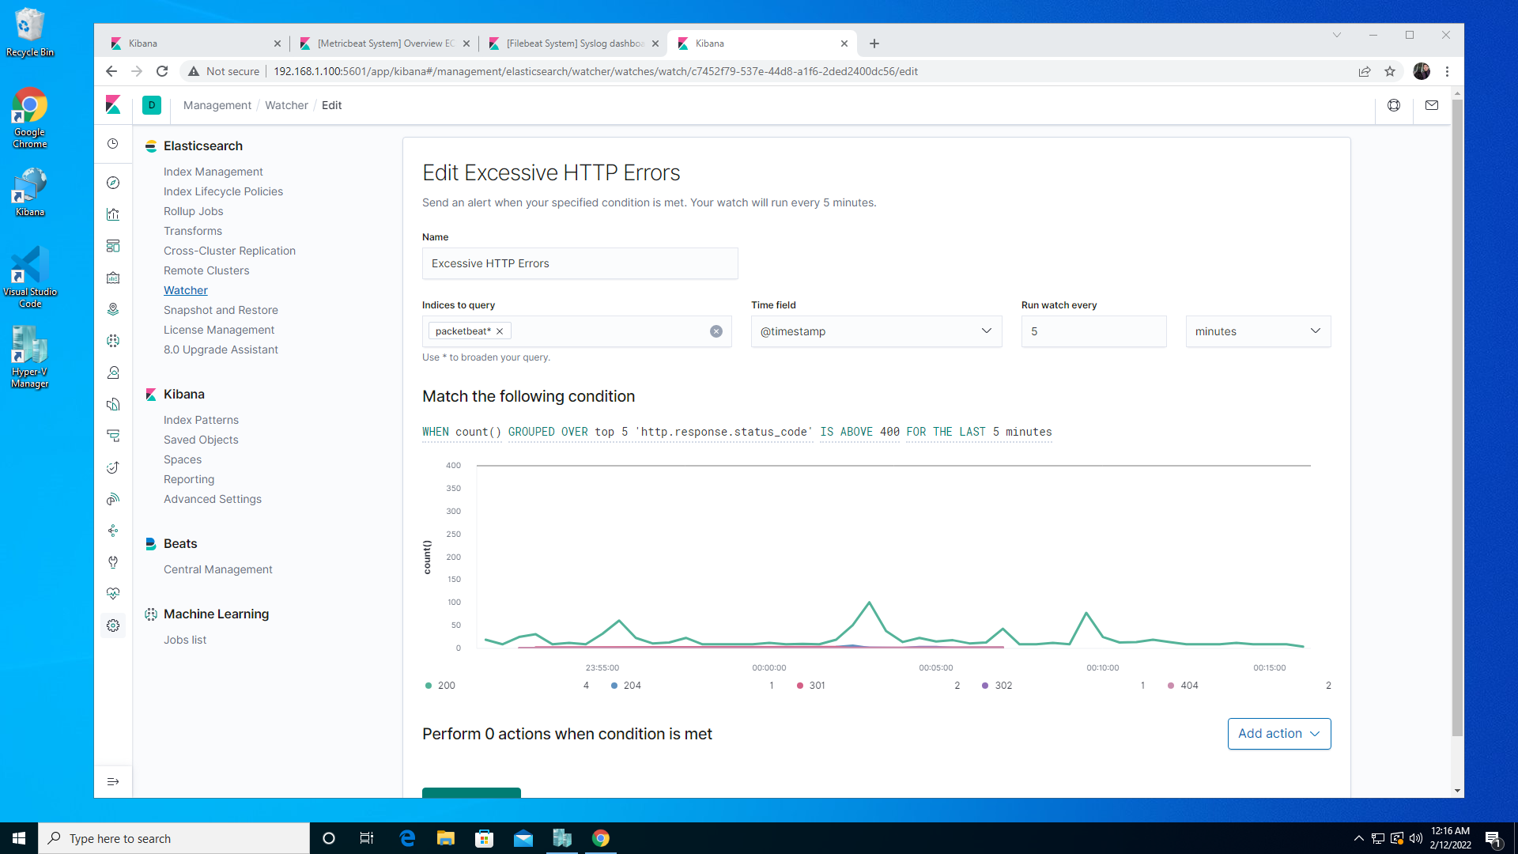
Excessive HTTP Errors
Metric: WHEN count() GROUPED OVER top 5 'http.response.status_code'
Threshold: IS ABOVE 400 FOR THE LAST 5 minutes

Slide 7
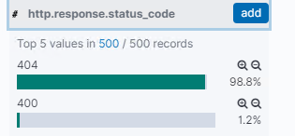
Excessive HTTP Errors
Metric: WHEN count() GROUPED OVER top 5 'http.response.status_code'
Threshold: IS ABOVE 400 FOR THE LAST 5 minutes
Vulnerability Mitigated: Status codes above 400 and 500 reflect HTTP errors.
Increased volume of HTTP status codes 400 and above may be an IOC (web page scans, brute force attacks etc)
This alert is highly reliable.
Error codes in the 400’s are server and client error codes which are of concern.
When analyzing this activity, there is only a single source IP (192.168.1.90) triggering this alert, and a single destination Port (80) and destination IP (192.168.1.110). There is also a single HTTP request method, HTTP GET. The majority of status codes are HTTP 404. URL PATH shows multiple URL resources attempting to be accessed.

Slide 8

HTTP Request Size
Metric: WHEN sum() of http.request.bytes OVER all documents
Threshold: IS ABOVE 3500

Slide 9
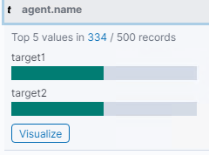
HTTP Request Size
Metric: WHEN sum() of http.request.bytes OVER all documents
Threshold: IS ABOVE 3500
Vulnerability Mitigated: This alert triggers when the server receives a HTTP request body over 3500 bytes in size. Large HTTP requests can be an IOC for attacks such as DDoS attacks (HTTP Flooding) etc.
This alert could create false positives (i.e medium reliability)
There could be confusion between malicious HTTP requests and legitimate HTTP requests
When analyzing this activity that is causing this alert, a single source IP (127.0.0.1) is sending HTTP GET packets to the same destination IP (127.0.0.1). The URL Path being accessed is /server-status, and two agent names are referenced, Target1 and Target2.

Slide 10

CPU Usage
Metric: WHEN max() OF system.process.cpu.total.pct OVER all documents
Threshold: IS ABOVE 0.5

Slide 11
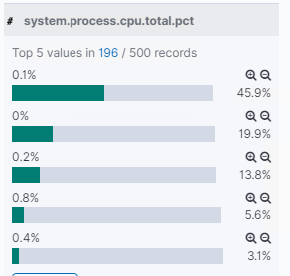
CPU Usage
Metric: WHEN max() OF system.process.cpu.total.pct OVER all documents
Threshold: IS ABOVE 0.5
Vulnerability Mitigated: This alert triggers if 50% of CPU is utilized within the last 5 minutes.
High CPU utilization can affect server performance OR be an IOC such as crypto jacking etc.
The alert is highly reliable.
This alert can help see how to more efficiently use the CPU even if there isn’t a malicious program running.
When analyzing this activity in metricbeat that is causing this alert, it is obvious that there are no unusual processes running in the background causing this alert. The packets contributing to this alert are caused by BAU OS and Application processes.

Slide 12
HARDENING

Slide 13
Hardening Against WordPress enumeration on Target 1
Patching
-Updating WordPress patches at regular basis
-Installing security plugins
-Disabling unsecured features –Remote procedure call & access to wp-config.php
-2 factor authentication & Locking account temporarily
- Least Privilege Policies to be re-defined
Why it works
-Patches from Vendor fixes vulnerabilities of applications that are susceptible to cyber-attacks
-Disabling RPC and access to wp-config.php prevent user enumeration and DB connection details
-Security plugins provide firewall feature and scanner for malwares
-2F authentication / Locking account to prevent Bruteforce attacks.
- Least privilege policies to address privilege escalations
<Files xmlrpc.php> order deny,allow deny from all </Files> | <files wp-config.php> order allow,deny deny from all </files>

Slide 14
Hardening Against xss/crlf on Target 1
Patching
-Sanitizing input data
-Limiting the size of URL/Http Request
-Set header security policies – Content security, Xframe option, Transport - security
Why the patch works
-Sanitizing input data detect malicious script in the data and reject it upfront
-Limiting the size would reject xss/crlf request as their size will be larger than average requests
-Implementing the security policies would reject the request body with - malicious content

Slide 15
Hardening Against High CPU Utilization on Target 1
Patching
-Regular security patch updates to OS
-Scheduled execution of Antivirus scanner
-Implementing Host based Intrusion detection(HIDS)
Why the patch works
-Regular update of OS patches ensure the zero-day vulnerabilities which can help install & execution of malicious application
-Antivirus detects malicious/infected programs and quarantine them
-Antivirus DB should be updated regularly for new virus signatures
-HID helps to protect system to download any malicious programs from network.

Slide 16
Implementing Patches with Ansible
Playbook Overview
WordPress update playbook steps
Stop httpd
Back-up html folder,DB
Get latest WordPress
Install
Update configuration from backup
Update .htaccess file
Start httpd
Explain which vulnerability each task in the playbook patches.
Get latest & Install WordPress for security patches
Update .htaccess file for disabling RPC and access to wp-config.php

